Slide 1
Agenda
What is HTML?
Basic Structure of an HTML Document
HTML Tags and Elements
Attributes in HTML
HTML Headings
Paragraphs and Formatting
Links and Images
Lists and Tables
Forms in HTML
Summary and QA

Slide 2
What is HTML?
Stands for HyperText Markup Language
Standard language for creating web pages
Describes the structure of a web page
Uses a series of elements and tags
HTML documents are plain text files
Rendered by web browsers
Essential for web development

Slide 3
HTML Versions
HTML was created by Sir Tim Berners-Lee in late 1991.
HTML 1.0 released in 1993 - sharing information - readable and accessible via web browsers.
HTML 2.0, published in 1995- all the features of HTML 1.0 along with that few additional features.
HTML 3.0, - Dave Raggett who introduced a fresh paper or draft - giving more powerful characteristics for webmasters in designing web pages.
But these powerful features of new HTML slowed down the browser
HTML 4.01, which is widely used and was a successful version of HTML
HTML 5 can be said for an extended version of HTML 4.01, which was published in the year 2012.

Slide 4
HTML Tags and Elements
Tags are the building blocks of HTML
Element consists of a start tag, content, and end tag
Example: <p>This is a paragraph.</p>
Empty elements: <br> or <img>
Case-insensitive but commonly written in lowercase
Can be nested within each other
Must be properly closed
mark-up languages are not compiled or interpreted, just displayed.
So even if mistakes are made, no error messages shown in Html, just the expected output will not be seen.

Slide 5
Attributes in HTML
Provide additional information about elements
Always included in the opening tag
Written as name/value pairs
Example: <a href="https://example.com">Link</a>
Common attributes: id, class, style
Must be quoted
Improve functionality and styling

Slide 6
Terminologies
WWW – World Wide Web.
HTML – HyperText Markup Language – The Language of Web Pages on the World Wide Web.
HTML is a text formatting language.
URL – Uniform Resource Locator.
Browser – A software program which is used to show web pages.
Pages end with “.htm” or “.html”

Slide 7
Html Editors
HTML Editor – A word processor that has been specialized to make the writing of HTML documents more effortless.
There are many different programs that you can use to create web documents.
HTML Editors enable users to create documents quickly and easily by pushing a few buttons. Instead of entering all of the HTML codes by hand.
These programs will generate the HTML Source Code for you.
Simplest too to create html documents is Notepad.

Slide 8
Html Editors
Adobe Dreamweaver
Bluefish
Google Web Designer
Sublime Text
CoffeeCup
HtmlKit
Mobirise
VSCode
Notepad ++

Slide 9
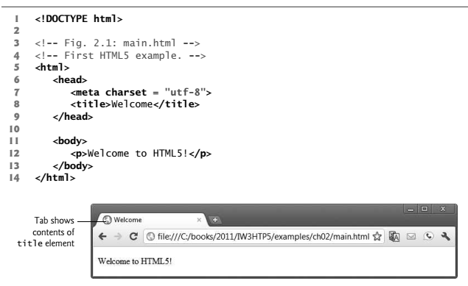
Creating a Basic Starting Document

Slide 10
Document type
First step in creating Html document is indicating its type.
Done with the help of <!DOCTYPE> declaration.
Required at the beginning of every Html document to help the browser how to render the Html document.
E.g. <!DOCTYPE Html>

Slide 11
HTML sections
<head>- Used to enclose information necessary to render the page, such as title, character encoding and external files required
<body> - This element delimits the content of the document.

Slide 12
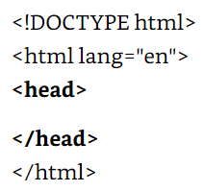
HTML sections
Html code inserterd between <Html> and </Html> divided into two main sections – Head and body.
Within head tag we will define title of the document, define encoding and provide general information.

Slide 13
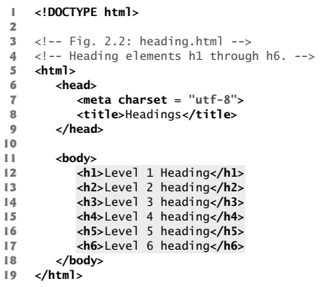
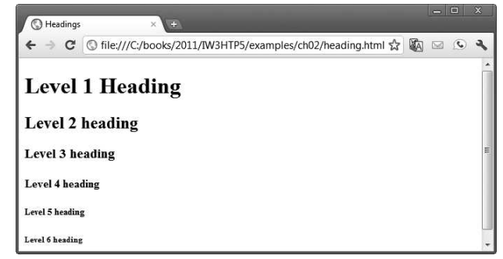
Heading element

Slide 14
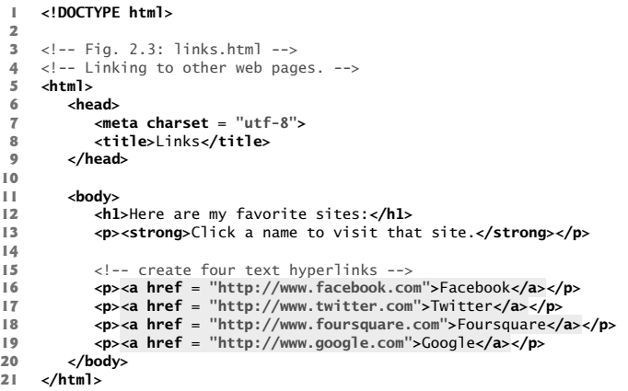
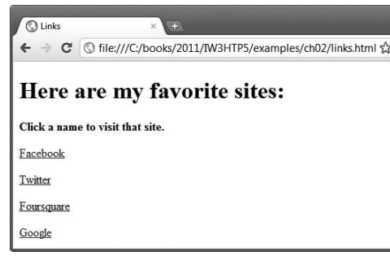
Linking Element

Slide 15
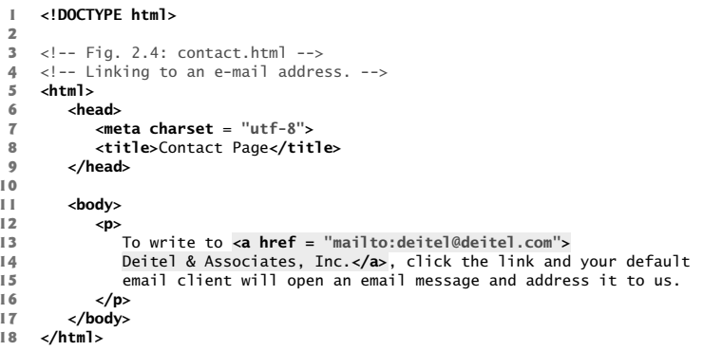
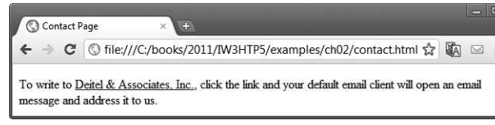
Hyperlink to email

Slide 16
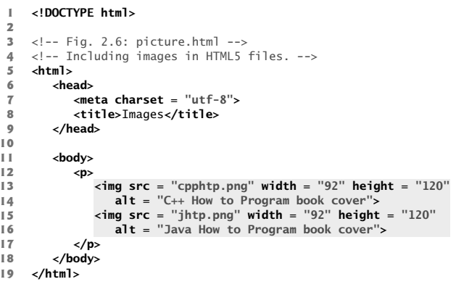
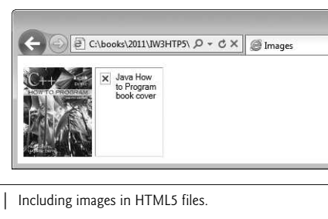
Images
document must have an alt attribute. If a browser cannot render an image, the browser displays the alt attribute’s value.

Slide 17
Image with Link
<a href="page.html"><img src="image.jpg" alt="Description"></a>
Combines image with link
Example: <a href="https://example.com"><img src="example.jpg" alt="Example Image"></a>
Clicking image navigates to https://example.com
Void Elements: contain only attributes and do not mark up text,
by using the forward slash character (/) inside the closing right angle bracket (>) of the start tag
<img src="logo.png" alt="logo“ width="150“ height="50“ > </img> normal tag
<img src="logo.png" alt="logo“ width="150“ height="50“ /> void element

Slide 18
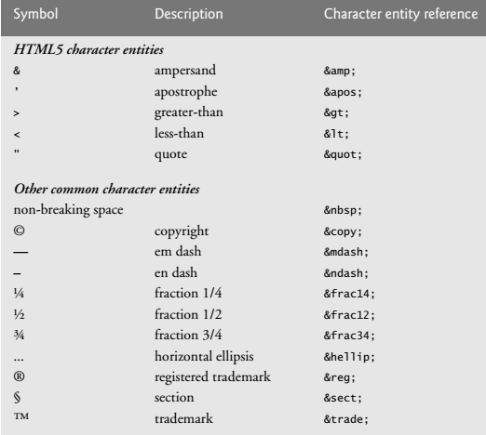
Special Characters and Horizontal rules
certain characters or symbols may be difficult to embed directly
<p> if x < 10 then increment x by 1</p>
<p>if x &lt; 10 then increment x by 1</p>

Slide 19
HTML Formatting Elements
<b> - Bold text
<strong> - Important text
<i> - Italic text
<em> - Emphasized text
<mark> - Marked text
<small> - Smaller text
<del> - Deleted text
<ins> - Inserted text
<sub> - Subscript text
<sup> - Superscript text

Slide 20
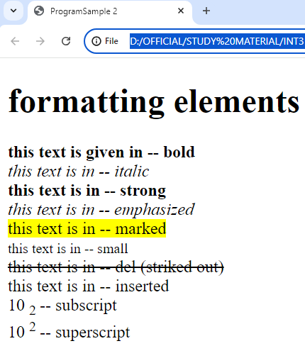
Program with Output
<!DOCTYPE html>
<html>
<head><title>ProgramSample 2</title></head>
<body>
<h1>formatting elements </h1>
<b> this text is given in -- bold </b> </br>
<i> this text is in -- italic </i> </br>
<strong> this text is in -- strong </strong></br>
<em> this text is in -- emphasized </em></br>
<mark> this text is in -- marked </mark></br>
<small> this text is in -- small </small></br>
<del> this text is in -- del (striked out)</del></br>
<in> this text is in -- inserted </in></br>
10
<sub> 2 </sub> -- subscript</br>
10
<sup> 2 </sup> -- superscript
</body>
</html>

Slide 21
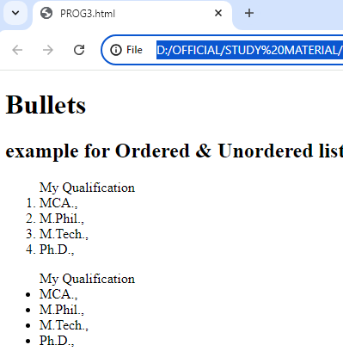
List
<!DOCTYPE html>
<html>
<body>
<h1> Bullets </h1>
<h2> example for Ordered &amp; Unordered list</h2>
<ol> My Qualification
<li>MCA.,</li>
<li>M.Phil.,</li>
<li>M.Tech.,</li>
<li>Ph.D.,</li>
</ol>
<ul> My Qualification
<li>MCA.,</li>
<li>M.Phil.,</li>
<li>M.Tech.,</li>
<li>Ph.D.,</li>
</ul>
</body>
</html>

Slide 22
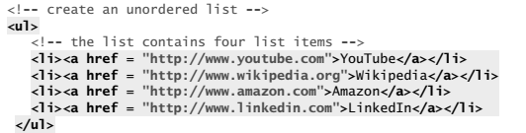
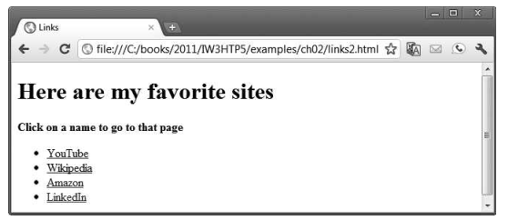
Un ordered List containing hyperlinks

Slide 23
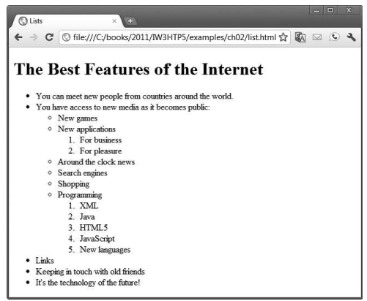
Can you make a code for this..?

Slide 24
Tables
A table represents information in a grid format.
Mainly used in alignment of controls in web page.
To create a basic table structure you need to use <table>, <tr> <th> and <td>.
<tr> is used to create row and
<td> will be used to create column.

Slide 25
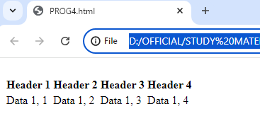
Tables
<table>
<tr>
<th>Header 1</th>
<th>Header 2</th>
<th>Header 3</th>
<th>Header 4</th>
</tr>
<tr>
<td>Data 1, 1</td>
<td>Data 1, 2</td>
<td>Data 1, 3</td>
<td>Data 1, 4</td>
</tr>
</table>

Slide 26
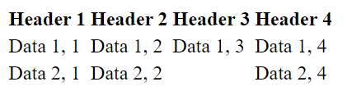
Tables
<table>
<tr>
<th>Header 1</th>
<th>Header 2</th>
<th>Header 3</th>
<th>Header 4</th>
</tr>
<tr>
<td>Data 1, 1</td>
<td>Data 1, 2</td>
<td>Data 1, 3</td>
<td>Data 1, 4</td>
</tr>
<tr>
<td>Data 2, 1</td>
<td>Data 2, 2</td>
<td></td>
<td>Data 2, 4</td>
</tr>
</table>
Empty Cell

Slide 27
Tables
Important Attributes:
<table>: border, align, width, height etc.,
Border – Border width. A number.
<td>: valign, halign, rowspan, colspan, width, height etc.,
Align, valign (vertical align) and halign (horizontal align): - center, left, right
Rowspan – to merge rows. A number.
Eg: if rowspan=2 for a particular td, current td will be merged with previous 1 row’s td.
Colspan – to merge columns. A number.
Eg: if colsspan=3 for a particular td, current td will be merged with previous 2 column’s td

Slide 28
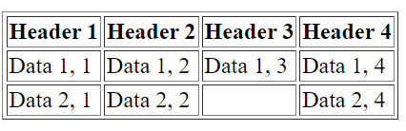
Tables
Border Property
<table border="1">
<tr>
<th>Header 1</th>
<th>Header 2</th>
<th>Header 3</th>
<th>Header 4</th>
</tr>
<tr>
<td>Data 1, 1</td>
<td>Data 1, 2</td>
<td>Data 1, 3</td>
<td>Data 1, 4</td>
</tr>
<tr>
<td>Data 2, 1</td>
<td>Data 2, 2</td>
<td></td>
<td>Data 2, 4</td>
</tr>
</table>

Slide 29
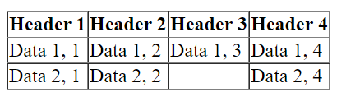
Tables
<table border="1" style="border-collapse: collapse">
<tr>
<th>Header 1</th>
<th>Header 2</th>
<th>Header 3</th>
<th>Header 4</th>
</tr>
<tr>
<td>Data 1, 1</td>
<td>Data 1, 2</td>
<td>Data 1, 3</td>
<td>Data 1, 4</td>
</tr>
<tr>
<td>Data 2, 1</td>
<td>Data 2, 2</td>
<td></td>
<td>Data 2, 4</td>
</tr>
</table>
CSS: Border Collapse

Slide 30
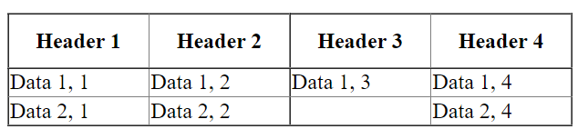
Tables
Specifying height for Head Row
<table border="1" style="border-collapse: collapse">
<tr height="40px">
<th width="100px">Header 1</th>
<th width="100px">Header 2</th>
<th width="100px">Header 3</th>
<th width="100px">Header 4</th>
</tr>
<tr>
<td>Data 1, 1</td>
<td>Data 1, 2</td>
<td>Data 1, 3</td>
<td>Data 1, 4</td>
</tr>
<tr>
<td>Data 2, 1</td>
<td>Data 2, 2</td>
<td></td>
<td>Data 2, 4</td>
</tr>
</table>
Specifying width for the columns

Slide 31
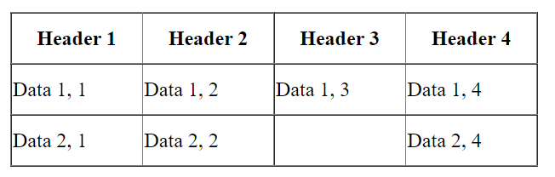
Tables
<table border="1" style="border-collapse: collapse">
<tr height="40px">
<th width="100px">Header 1</th>
<th width="100px">Header 2</th>
<th width="100px">Header 3</th>
<th width="100px">Header 4</th>
</tr>
<tr height="40px">
<td>Data 1, 1</td>
<td>Data 1, 2</td>
<td>Data 1, 3</td>
<td>Data 1, 4</td>
</tr>
<tr height="40px">
<td>Data 2, 1</td>
<td>Data 2, 2</td>
<td></td>
<td>Data 2, 4</td>
</tr>
</table>
Specifying Height for all rows

Slide 32
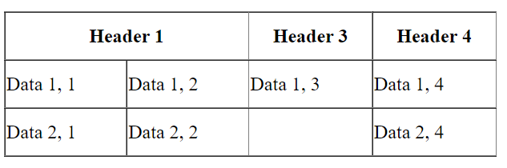
Tables
<table border="1" style="border-collapse: collapse">
<tr height="40px">
<th width="200px" colspan="2">Header 1</th>
<th width="100px">Header 3</th>
<th width="100px">Header 4</th>
</tr>
<tr height="40px">
<td>Data 1, 1</td>
<td>Data 1, 2</td>
<td>Data 1, 3</td>
<td>Data 1, 4</td>
</tr>
<tr height="40px">
<td>Data 2, 1</td>
<td>Data 2, 2</td>
<td></td>
<td>Data 2, 4</td>
</tr>
</table>
Merging cells from two columns
Next Column in that row should be empty

Slide 33
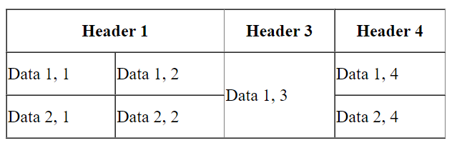
Tables
<table border="1" style="border-collapse: collapse">
<tr height="40px">
<th width="200px" colspan="2">Header 1</th>
<th width="100px">Header 3</th>
<th width="100px">Header 4</th>
</tr>
<tr height="40px">
<td>Data 1, 1</td>
<td>Data 1, 2</td>
<td rowspan="2">Data 1, 3</td>
<td>Data 1, 4</td>
</tr>
<tr height="40px">
<td>Data 2, 1</td>
<td>Data 2, 2</td>
<td>Data 2, 4</td>
</tr>
</table>
Merging cells from two rows
In next row, corresponding cell should be empty

Slide 34
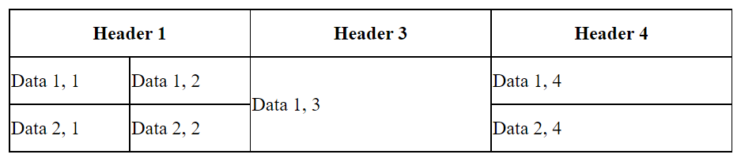
Tables
<table>
<tr>
<th colspan="2">Header 1</th>
<th>Header 3</th>
<th>Header 4</th>
</tr>
<tr>
<td>Data 1, 1</td>
<td>Data 1, 2</td>
<td rowspan="2">Data 1, 3</td>
<td>Data 1, 4</td>
</tr>
<tr>
<td>Data 2, 1</td>
<td>Data 2, 2</td>
<td>Data 2, 4</td>
</tr>
</table>
<style> table, th, td
{
border: 1px solid black;
border-collapse: collapse;
}
th
{
width: 200px;
}
tr
{
height: 40px;
}
</style>

Slide 35
Fieldset - Legend
Fieldset
Group thematically related controls and labels in a form.
[Grouping controls makes it easier for users to understand their purpose while simultaneously facilitating tabbing navigation]
Draws a box around the related elements.
Legend
Used to define a caption for the <fieldset> element.
Improves accessibility

Slide 36
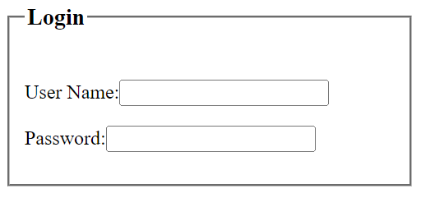
Fieldset & Legend
<fieldset style="width: 300px">
<legend><h3>Login</h3></legend>
<p>User Name:<input type="text"></p>
<p>Password:<input type="password"></p>
</fieldset>

Slide 37
Div Element
Defines a division or a section in an HTML document
Used as a container for HTML elements
Styled with CSS
Manipulated with JavaScript
Easily styled by using the class or id attribute
Any sort of content can be put inside the <div> tag!
By default, browsers always place a line break before and after the <div> element.

Slide 38
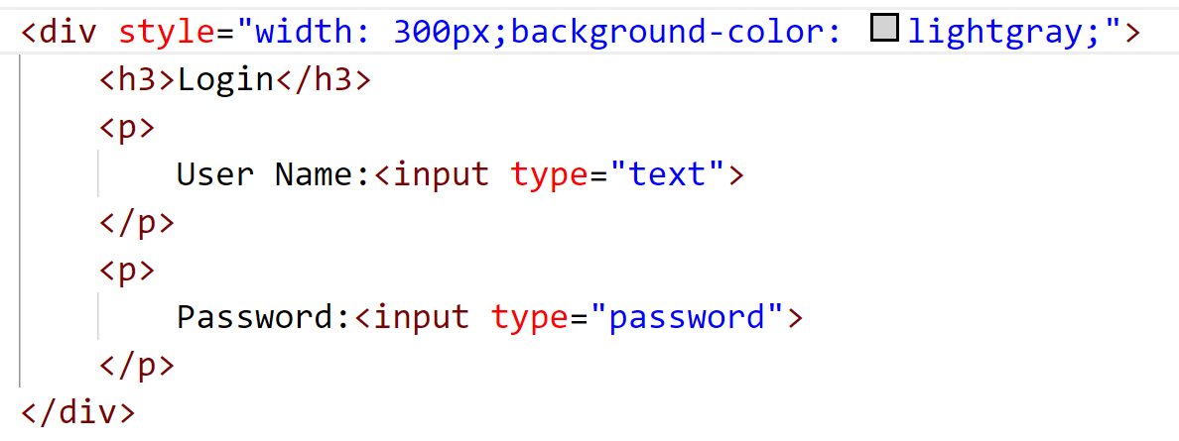
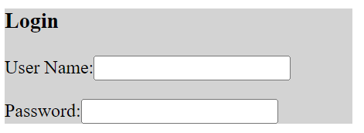
Div Element

Slide 39
Section Element
Represents a generic standalone section of a document, which doesn't have a more specific semantic element to represent it.
Defines the section of documents such as chapters, headers, footers or any other sections.
Sections should always have a heading, with very few exception.

Slide 40
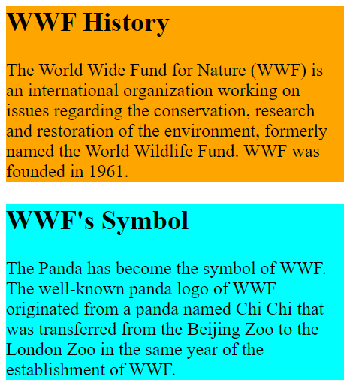
section Element
<section id="1" style="background-color:orange;width: 300px;">
<h2>WWF History</h2>
<p>The World Wide Fund for Nature (WWF) is an
international organization working on issues
regarding the conservation,
research and restoration of the environment,
formerly named the World Wildlife Fund.
WWF was founded in 1961.</p>
</section>
<section id="2" style="background-color:aqua;width: 300px;">
<h2>WWF's Symbol</h2>
<p>The Panda has become the symbol of WWF.
The well-known panda logo of WWF originated
from a panda named Chi Chi that was transferred
from the Beijing Zoo to the London Zoo
in the same year of the establishment of WWF.</p>
</section>

Slide 41
Header & Footer Elements
Header
Creates a header-content that usually appears at the top of the page contains both text and graphics.
Can be used multiple times on a page and can include HTML headings (<h1> through <h6>), navigation, images and logos and more.
Footer
Describes a footer—content that usually appears at the bottom of the page or section element.

Slide 42
figure Element and figcaption Element
Figure element
Describes a figure (such as an image, chart or table) in the document so that it could be moved to the side of the page or to another page.
Figcaption element
provides a caption for the image in the figure element.

Slide 43
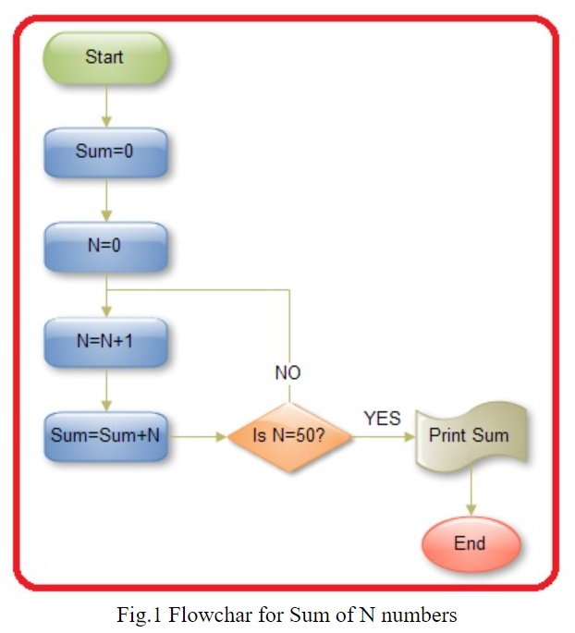
figure Element and figcaption Element
<figure align="center">
<img src="images\sumflow.jpg">
<figcaption>Fig.1 Flowchar for Sum of N numbers</figcaption>
</figure>

Slide 44
Other Page Structure Elements

Slide 45
Page-Structure Elements
HTML5 introduces several new page-structure elements (Fig. 3.18) that meaningfully identify areas of the page as headers, footers, articles, navigation areas, asides, figures and more.

Slide 46
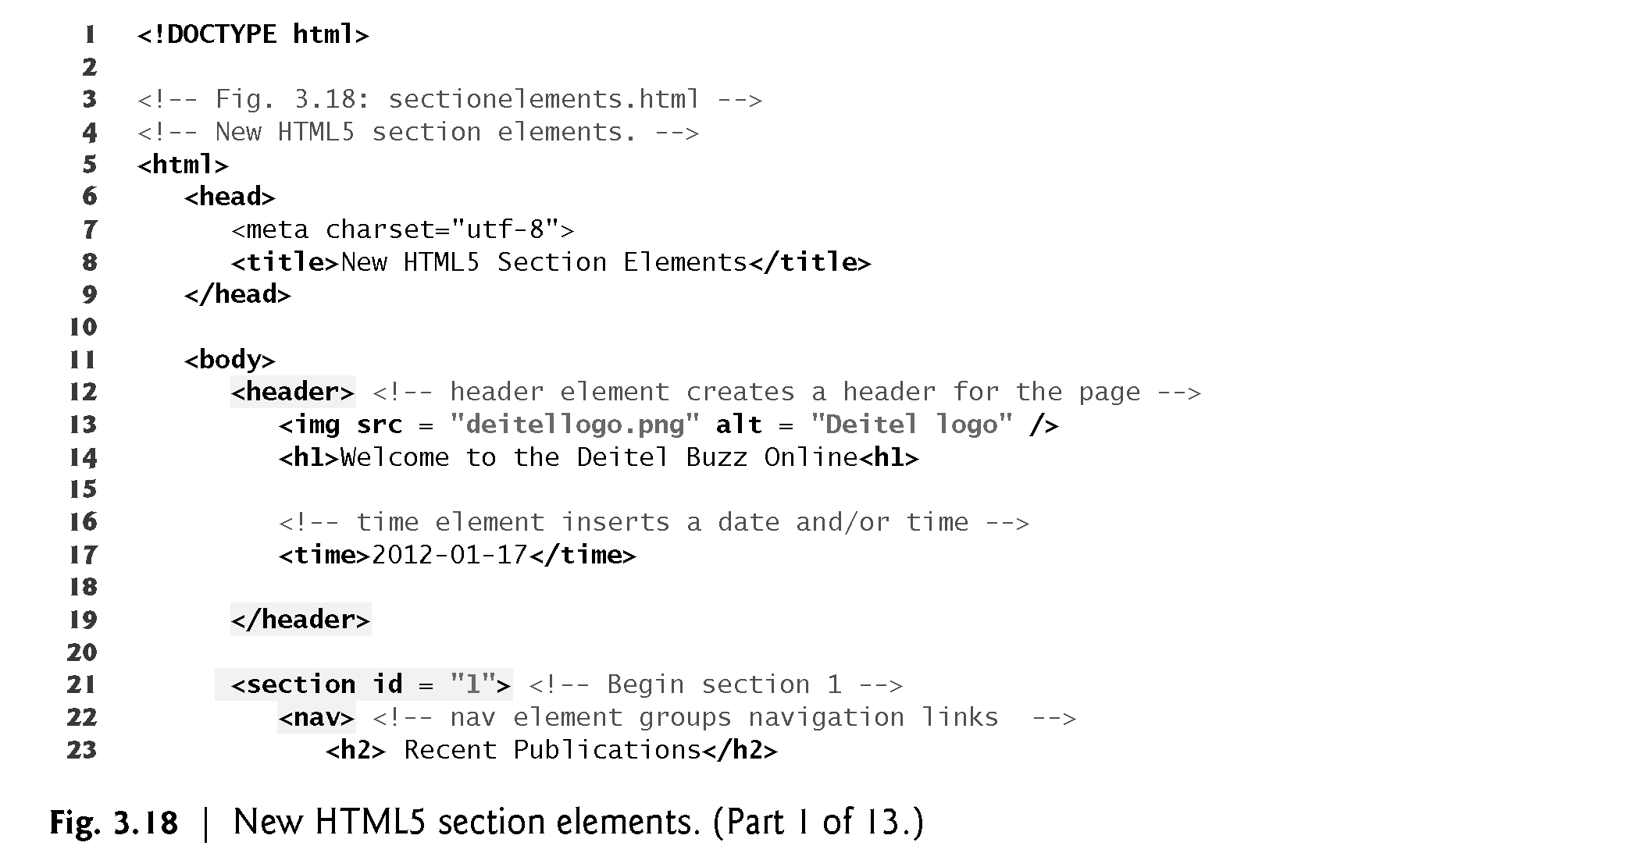

Slide 47
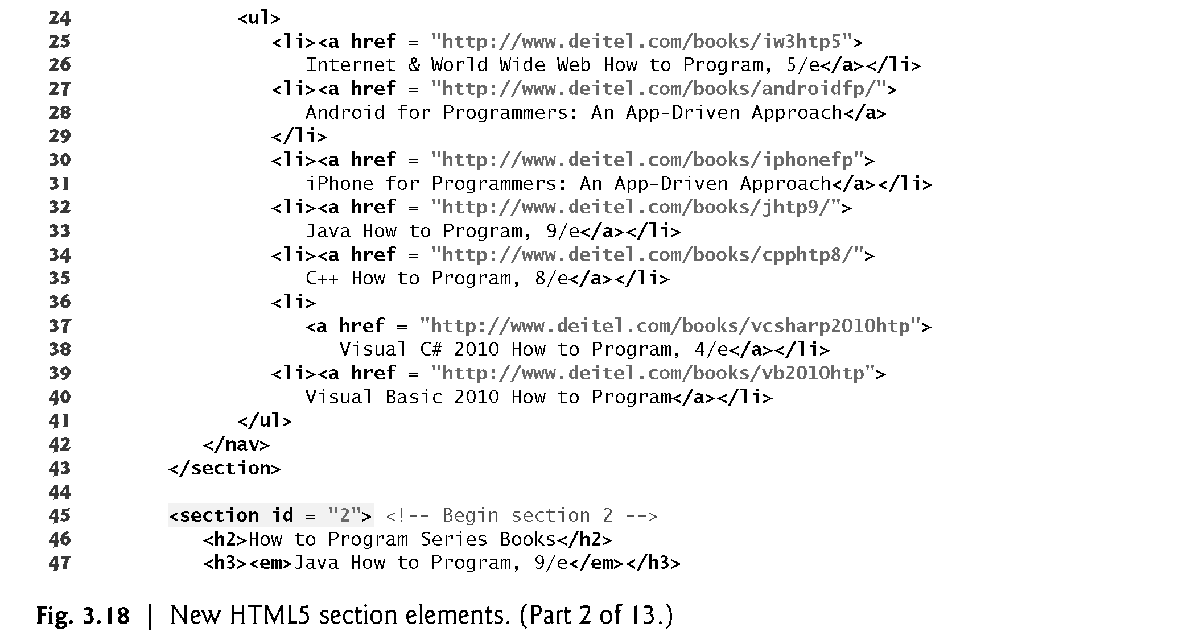

Slide 48
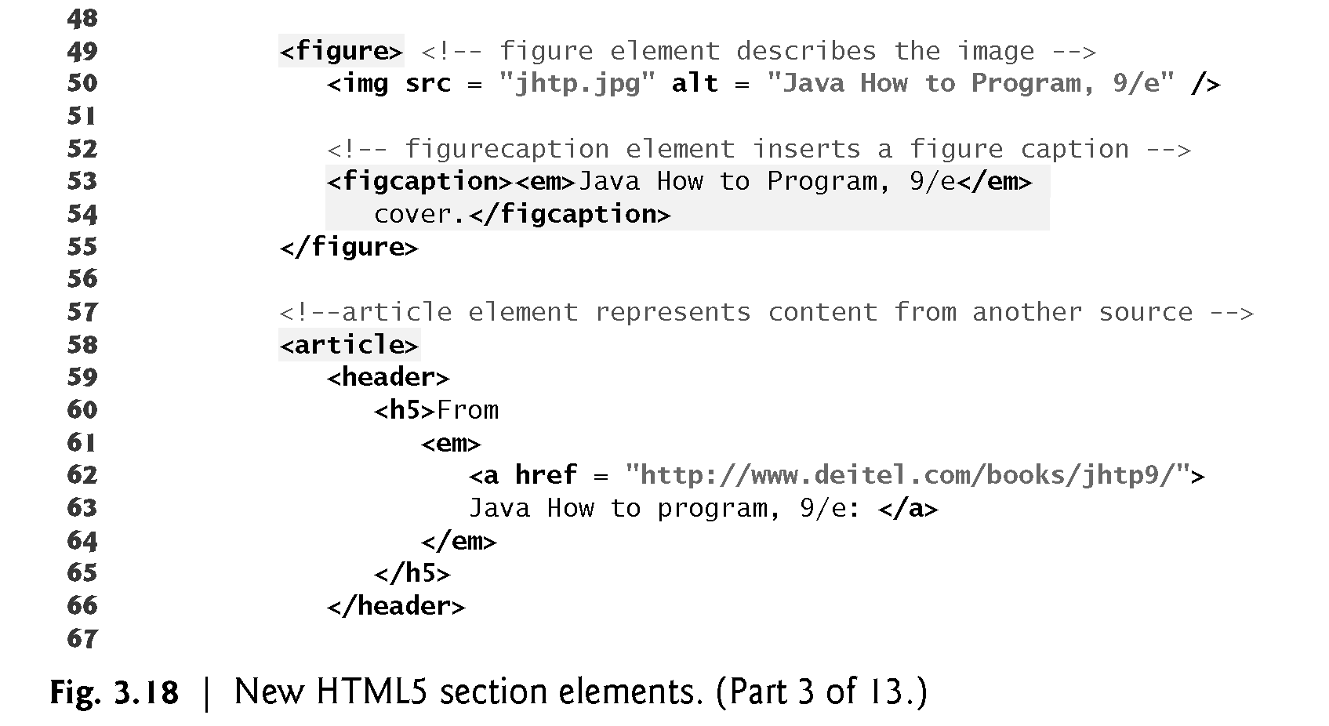

Slide 49
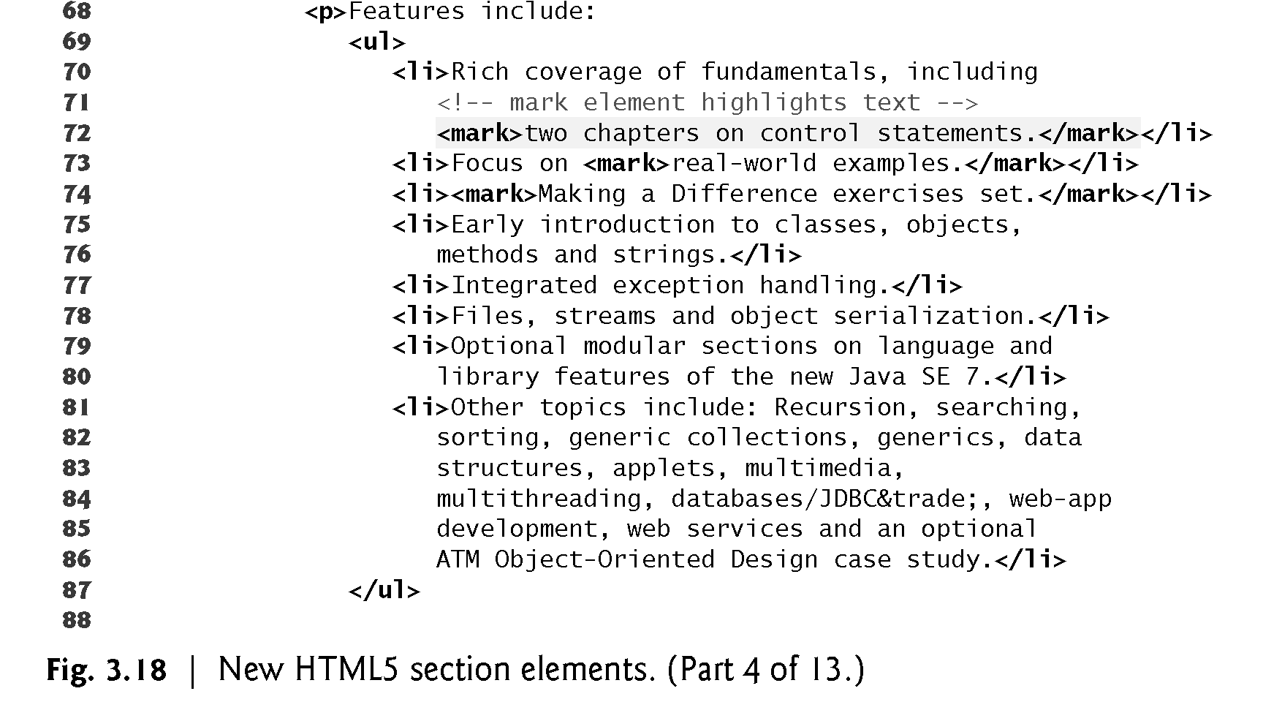

Slide 50
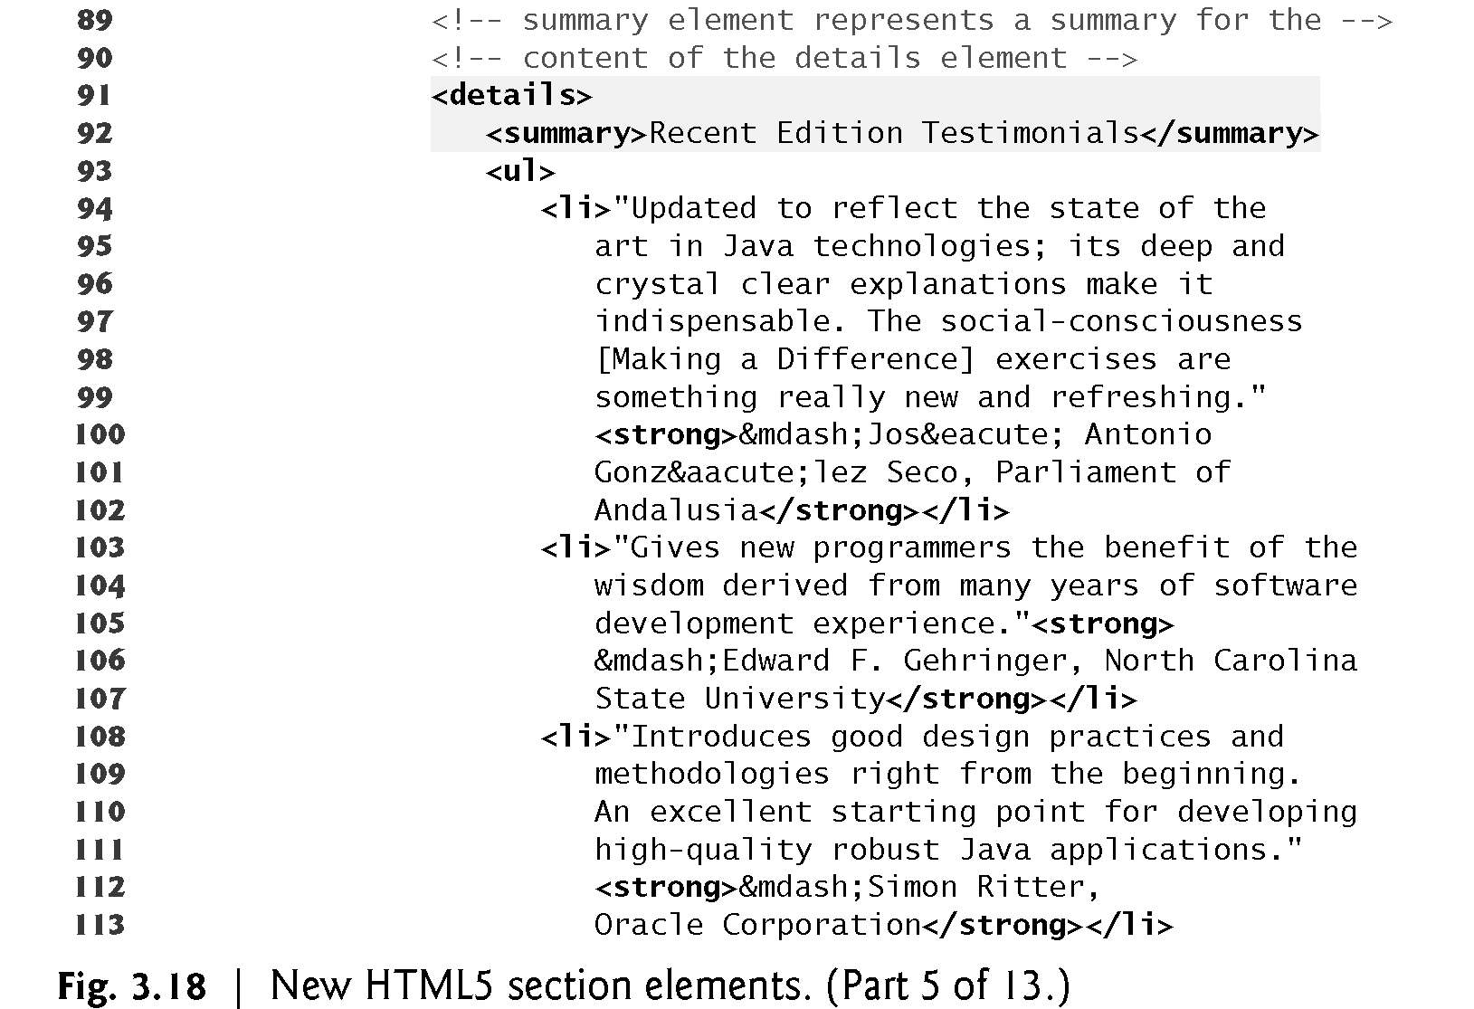

Slide 51
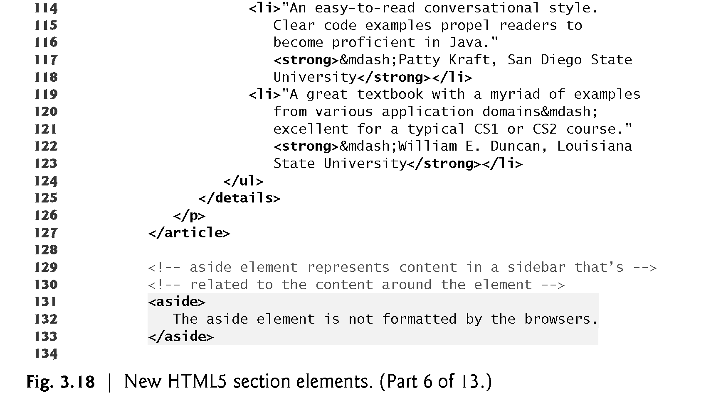

Slide 52
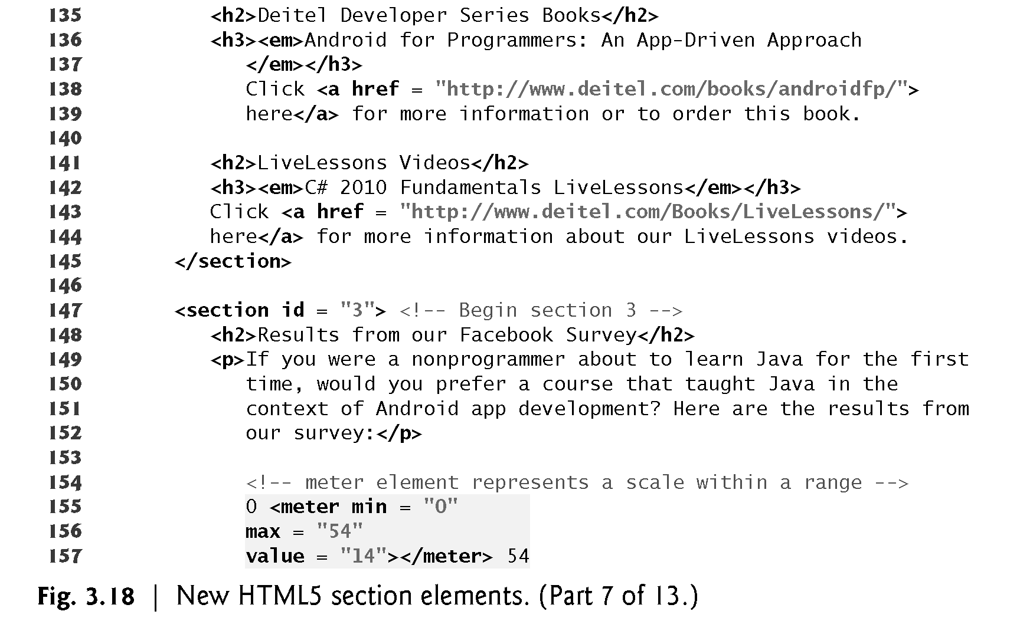

Slide 53
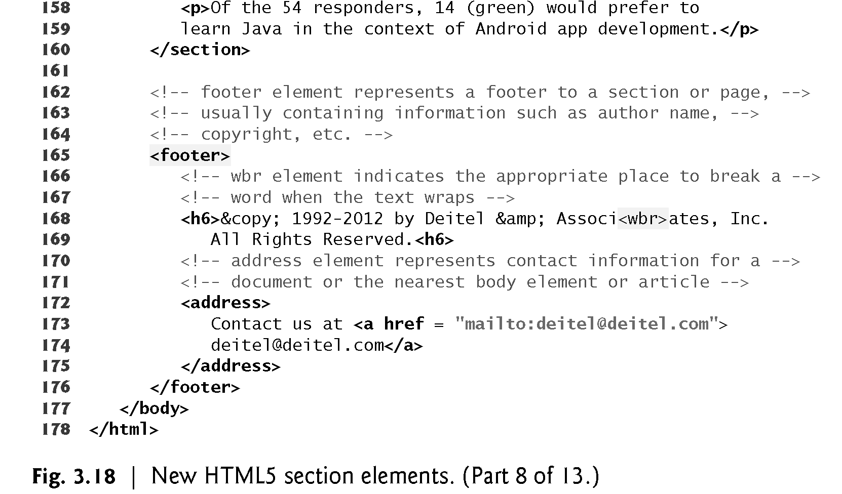

Slide 54
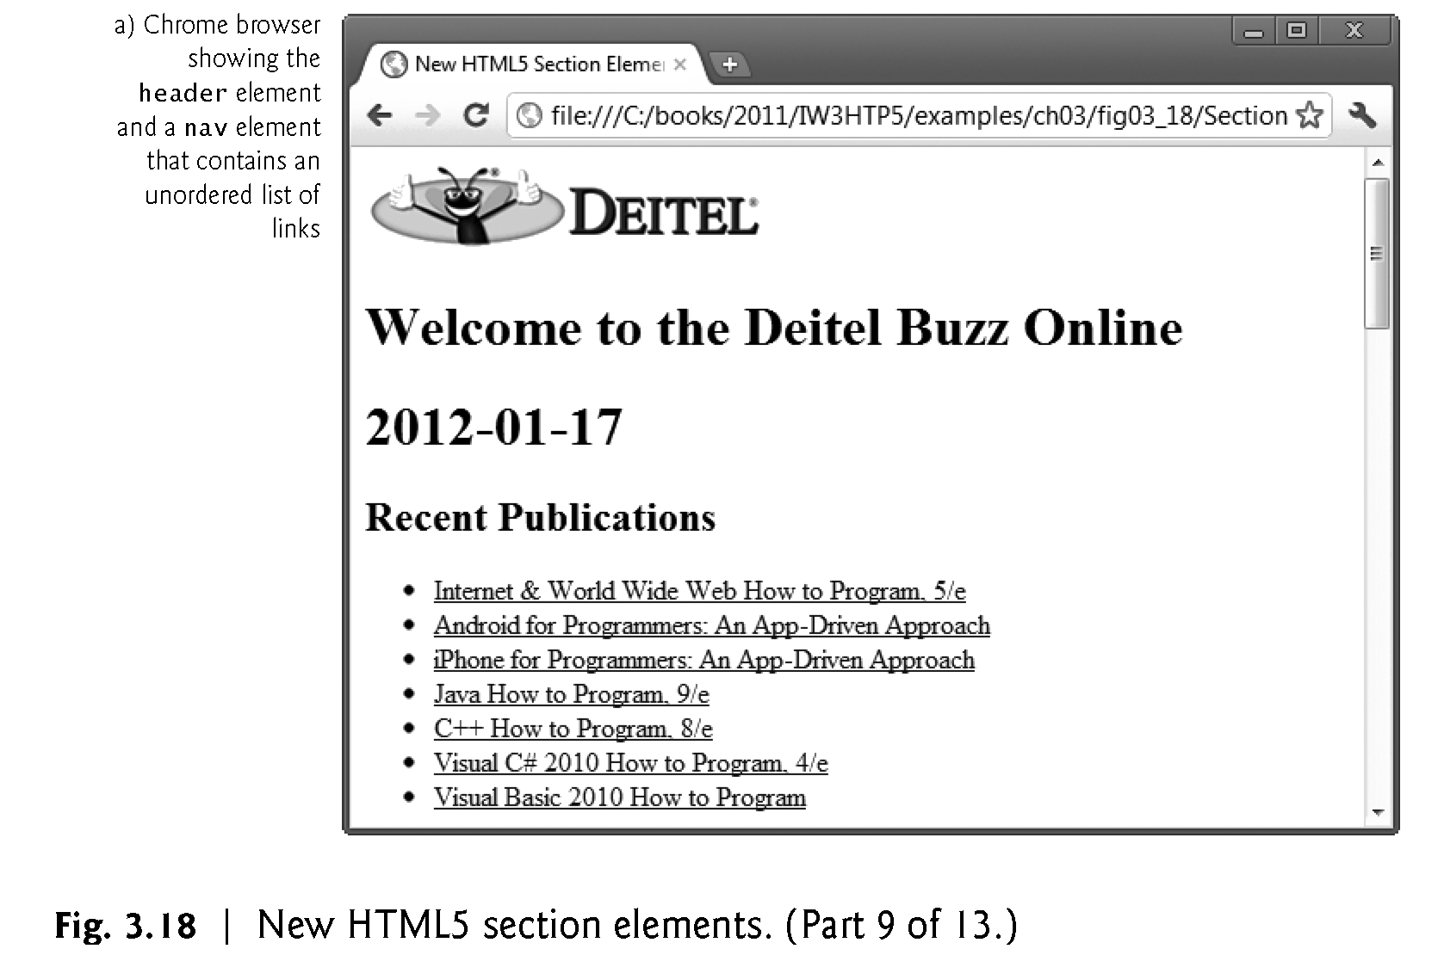

Slide 55
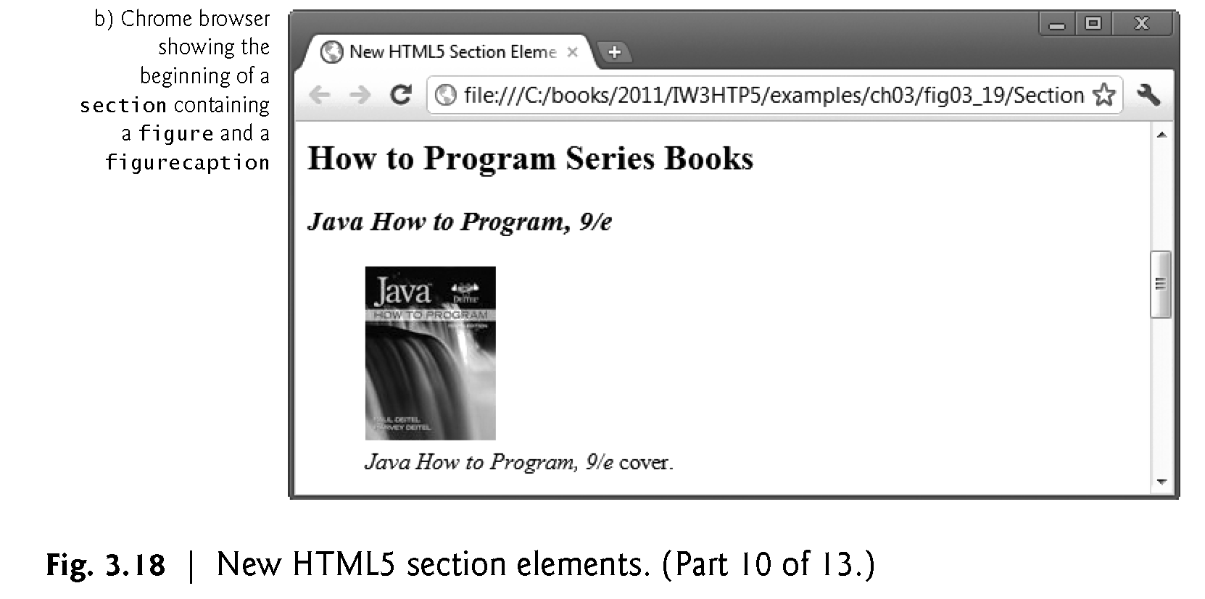

Slide 56
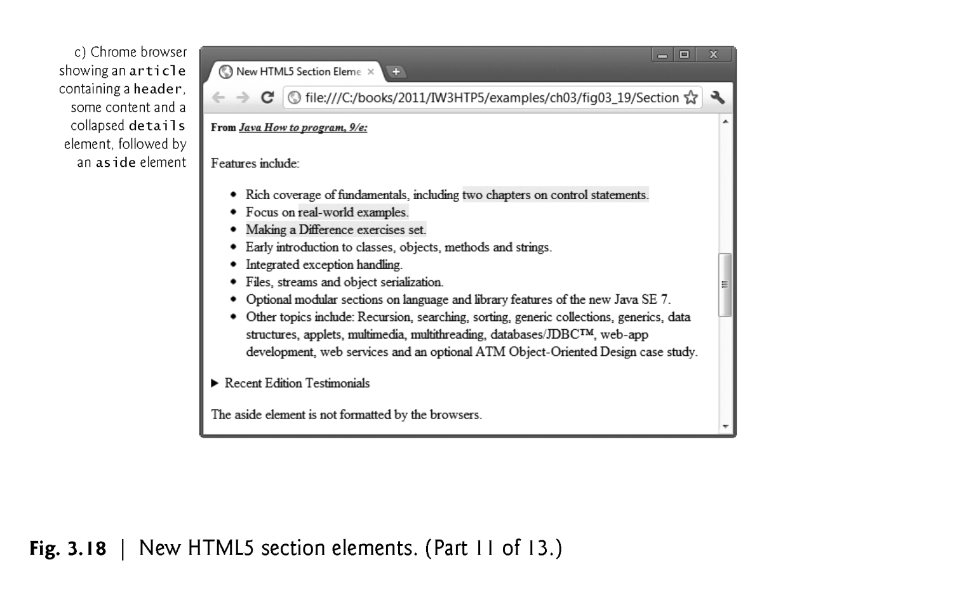

Slide 57
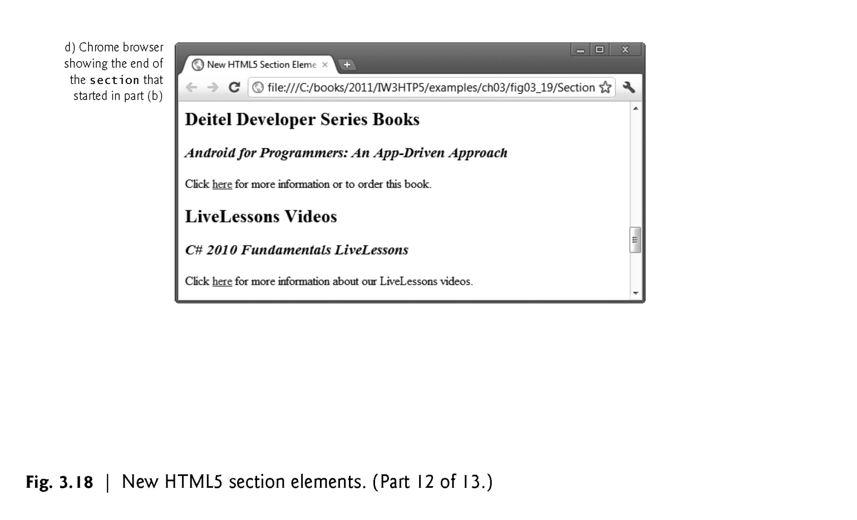

Slide 58
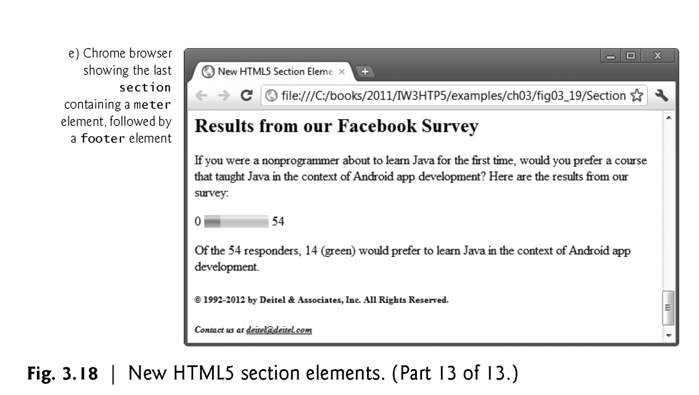

Slide 59
nav Element
The nav element groups navigation links.
In this example, we used the heading Recent Publications and created a ul element with seven li elements that link to the corresponding web pages for each book.

Slide 60
article Element
The article element describes standalone content that could potentially be used or distributed elsewhere, such as a news article, forum post or blog entry.
You can nest article elements. For example, you might have reader comments about a magazine nested as an article within the magazine article.

Slide 61
summary Element and details Element
The summary element displays a right-pointing arrow next to a summary or caption when the document is rendered in a browser (Fig. 3.19).
When clicked, the arrow points downward and reveals the content in the details element.

Slide 62
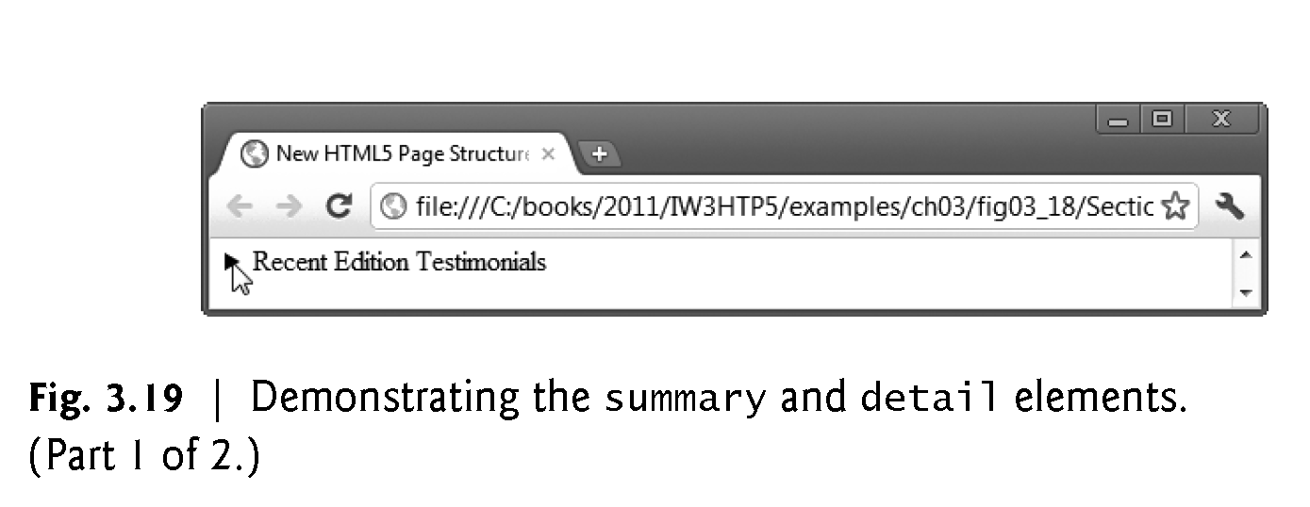

Slide 63
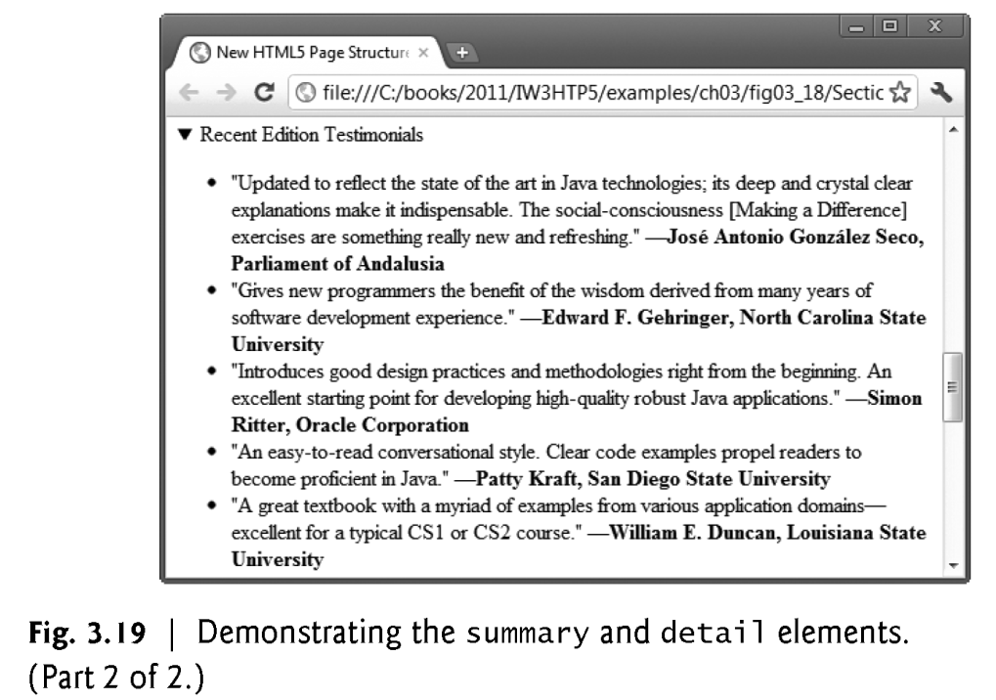

Slide 64
aside Element
The aside element describes content that’s related to the surrounding content (such as an article) but is somewhat separate from the flow of the text.
For example, an aside in a news story might include some background history.

Slide 65
meter Element
The meter element renders a visual representation of a measure within a range (Fig. 3.20).
In this example, we show the results of a recent web survey we did.
The min attribute is "0" and a max attribute is "54" —indicating the total number of responses to our survey.
The value attribute is "14", representing the total number of people who responded “yes” to our survey question.

Slide 66
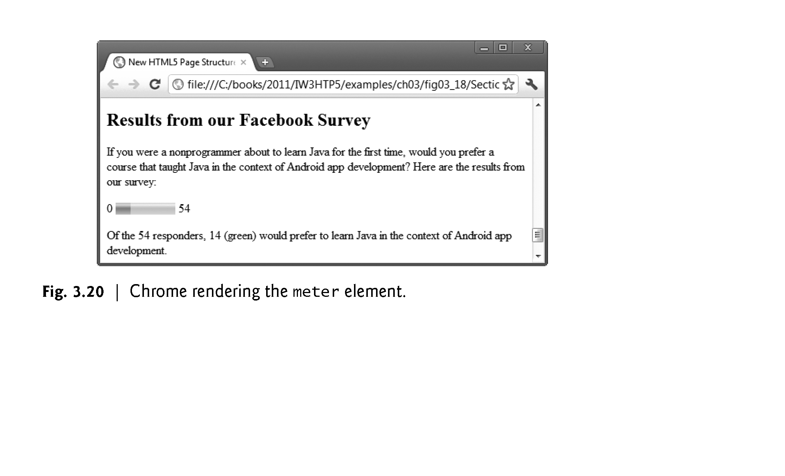

Slide 67
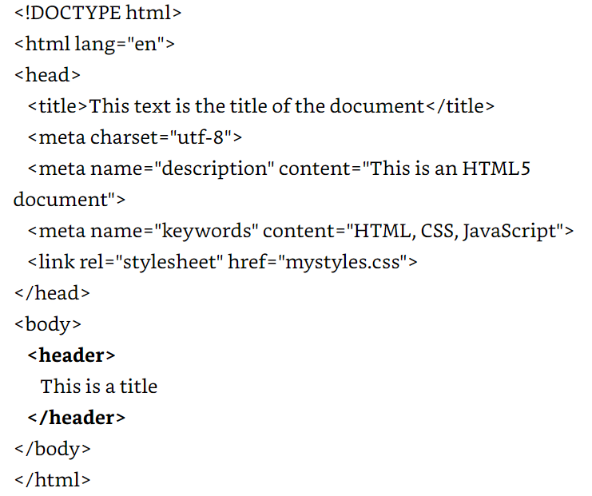
Elements are declared in the same order in which they are displayed on browser from top to bottom and left to right.

Slide 68
Global Attributes
Some structure elements may be used multiple times in a document to represent different parts of the structure.
For this reason Html defines Global attributes that we can use to assign custom identifiers to each element.
Id – Assigns a unique identifier to an element
Class- Assigns the same identifier to a group of elements.

Slide 69
Id Vs Class
Id attribute identifies independent elements with a unique value, but the class attribute may be duplicated to associate elements with similar characteristics.
If we have two or more <section> elements which we need to differentiate then we can assign id attribute to each one of them with unique values.

Slide 70
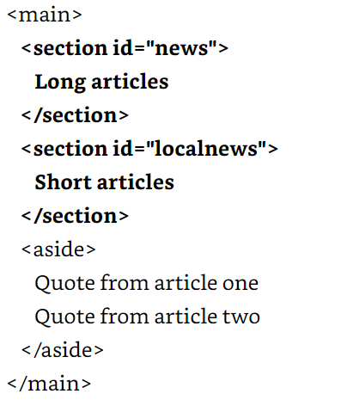

Slide 71
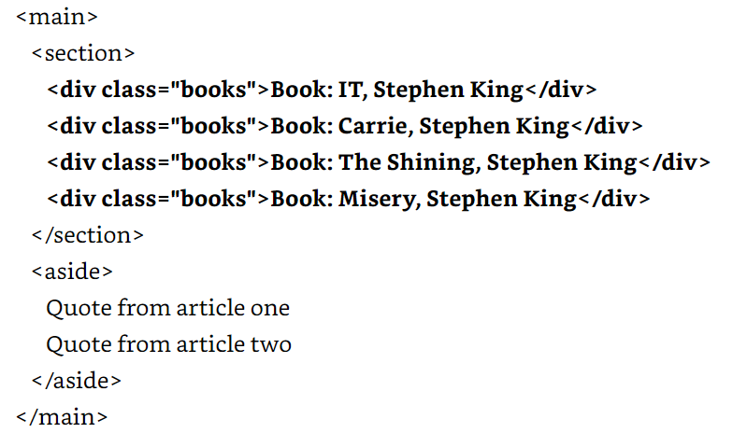
On the other hand, if we need to identify a group of elements that share similar characteristics, we can use the class attribute.

Slide 72
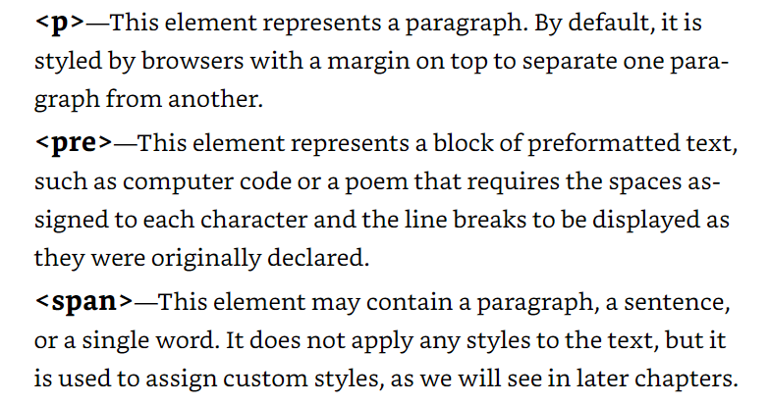

<p>, <pre>, <span>

Slide 73



Slide 74


Slide 75
Demo
Develop a simple HTML page with Title, Head and Body. Make use of the following tags
P
Pre
Br
I
B
U
Strong

Slide 76
Background Color
It is very common to see web pages with their background color set to white or some other colors.
To set your document’s background color, you need to edit the <BODY> element by adding the BGCOLOR attribute.
The following example will display a document with a white background color:
<BODY BGCOLOR=“#FFFFFF”></BODY>

Slide 77
TEXT Color
The TEXT attribute is used to control the color of all the normal text in the document. The default color for text is black.
The TEXT attribute would be added as follows:
<BODY BGCOLOR=“#FFFFFF” TEXT=“#FF0000”></BODY>
In this example the document’s page
color is white and the text would be red

Slide 78
Using Image Background
The BODY element also gives you ability of setting an image as the document’s background.
An example of a background image’s HTML code is as follows:
<BODY BACKGROUND=“hi.gif” BGCOLOR=“#FFFFFF”></BODY>

Slide 79
Aligning Text
The ALIGN attribute can be inserted in the <P> and <Hn> tags to right justify, center, or left justify the text
For example, <H1 ALIGN=CENTER> The New York Times </H1> would create a centered heading of the largest size

Slide 80
Comment Statements
Comment statements are notes in the HTML code that explain the important features of the code
The comments do not appear on the Web page itself but are a useful reference to the author of the page and other programmers
To create a comment statement use the <!-- …. --> tags

Slide 81
Blink Tag
It is possible to make text blink using the <BLINK> … </BLINK> tag
However, it is best to use this feature at most sparingly or not at all; What seems like a good idea to a Web designer can become very annoying to a Web user
The <BLINK> tag is not supported by Internet Explorer

Slide 82
Page Formatting
To define the background color, use the BGCOLOR attribute in the <BODY> tag
To define the text color, use the TEXT attribute in the <BODY> tag
To define the size of the text, type <BASEFONT SIZE=n>

Slide 83
Example
<HTML>
<HEAD>
<TITLE> Example </TITLE>
</HEAD>
<BODY BGCOLOR=“black” TEXT=“white”>
<BASEFONT SIZE=7>
This is where you would include the text and images on your Web page.
</BODY>
</HTML>

Slide 84
Inserting Images
Type <IMG SRC = “image.ext”>, where image.ext indicates the location of the image file
The WIDTH=n and HEIGHT=n attributes can be used to adjust the size of an image
The attribute BORDER=n can be used to add a border n pixels thick around the image

Slide 85
Alternate Text
Some browsers don’t support images. In this case, the ALT attribute can be used to create text that appears instead of the image.
Example:
<IMG SRC=“satellite.jpg” ALT = “Picture of satellite”>

Slide 86
Links
A link lets you move from one page to another, play movies and sound, send email, download files, and more….
A link has three parts: a destination, a label, and a target
To create a link type
<A HREF=“page.html”> label </A>

Slide 87
Anatomy of a Link
<A HREF=“page.html”> label </A>
In the above link, “page.html” is the destination. The destination specifies the address of the Web page or file the user will access when he/she clicks on the link.
The label is the text that will appear underlined or highlighted on the page

Slide 88
Example: Links
To create a link to CNN, I would type:
<A HREF=“http://www.cnn.com”>CNN</A>
To create a link to MIT, I would type:
<A HREF=“http://www.mit.edu”>MIT</A>

Slide 89
Changing the Color of Links
The LINK, VLINK, and ALINK attributes can be inserted in the <BODY> tag to define the color of a link
LINK defines the color of links that have not been visited
VLINK defines the color of links that have already been visited
ALINK defines the color of a link when a user clicks on it

Slide 90
Using Links to Send Email
To create a link to an email address, type <A HREF=“mailto:email_address”> Label</A>
For example, to create a link to send email to myself, I would type: <A HREF=“mailto: ktdunn@mit.edu”>email Katie Dunn</A>

Slide 91
Anchors
Anchors enable a user to jump to a specific place on a Web site
Two steps are necessary to create an anchor. First you must create the anchor itself. Then you must create a link to the anchor from another point in the document.

Slide 92
Anchors
To create the anchor itself, type <A NAME=“anchor name”>label</A> at the point in the Web page where you want the user to jump to
To create the link, type <A HREF=“#anchor name”>label</A> at the point in the text where you want the link to appear

Slide 93

Example: Anchor
<A HREF="#chap2">Chapter Two</A><BR>
Link
<A NAME="chap2">Chapter 2 </A>
Anchor

Slide 94
Forms
What are forms?
An HTML form is an area of the document that allows users to enter information into fields.
A form may be used to collect personal information, opinions in polls, user preferences and other kinds of information.

Slide 95
Forms
There are two basic components of a Web form: the shell, the part that the user fills out, and the script which processes the information
HTML tags are used to create the form shell. Using HTML you can create text boxes, radio buttons, checkboxes, drop-down menus, and more...

Slide 96

Example: Form
Text Box
Drop-down List
Radio Buttons
Checkboxes
Text Area
Reset Button
Submit Button

Slide 97
Contact form
Registration form
Sign-in Form
Lead generation form
Order form
Survey form
Search form
Email form

Slide 98
The Form Shell
A form shell has three important parts:
the <FORM> tag, which includes the address of the script which will process the form
the form elements, like text boxes and radio buttons
the submit button which triggers the script to send the entered information to the server

Slide 99
Syntax
<form>
<!-- HTML Form Element -->
</form>

Slide 100
Creating the Shell
To create a form shell, type <FORM METHOD=POST ACTION=“script_url”> where “script_url” is the address of the script
Create the form elements
End with a closing </FORM> tag

Slide 101
<form action="signin.php“ method="post">
<!-- HTML Form Element -->
</form>

Slide 102
The <form> element has two important attributes, the action attribute, and the method attribute.
Here, the form action specifies the location where the form data will be submitted, and the form method specifies the HTTP method that is usually GET / POST.
If you do not specify the action and method attribute in the form element, the default action will be the current page, and the method will be GET.

Slide 103
text | It defines a single-line text field. | <input type="text">
email | It defines a single-line text field for an e-mail address. The input value is automatically verified to ensure correctly formatted email addresses. | <input type="email">
password | It defines a single-line text field for password. | <input type="password">
radio | It defines a radio button. Radio buttons are usually presented in a radio group and allow the user to select only one option. | <input type="radio">

Slide 104
checkbox | It defines a checkbox button. Checkbox buttons are usually presented in a group and allow the user to select multiple options. | <input type="checkbox">
file | File input provides a browse button to select files to upload. On clicking the button, it opens a file picker dialog from which the user can select files. | <input type="file">

Slide 105
image | Image input provides a browse button to select images for upload. On clicking the button, it opens a file picker dialog from which the user can select only images. | <input type="image">
hidden | Hidden inputs are invisible from users. They allow developers to get some textual data that the user cannot see. | <input type="hidden">

Slide 106
submit | The submit input creates a submit button. On clicking the button, It submits all the form elements to the form handler. | <input type="submit">
reset | The reset input creates a reset button. On clicking the button, It reset all the form elements value to the default state. | <input type="file">
button | The button input creates a simple button that can be programmed to perform some action. | <input type="button">

Slide 107
HTML 5 Input Types
number | It defines a single-line text field for only numbers. | <input type="number">
tel | It defines a single-line text field for telephone numbers. | <input type="tel">
range | It displays a slider to set the value of an input element. | <input type="range">
url | It defines a single-line text field for a URL address. The input value is automatically verified to ensure a correctly formatted URL. | <input type="url">

Slide 108
HTML 5 Input Types
search | It defines a single-line text field that is styled differently by web browsers. | <input type="search">
color | It provides an interface to select colors using a visual color picker. | <input type="color">
date | It displays a calendar to select a date that is styled differently by different web browsers. | <input type="date">

Slide 109
<form name="Search" method="post" action="search.php" >
<label for="q">Search:</label><br />
<input type="search" name="q" id="q" /> <br/>
<input type="submit" value="Go" />
</form>

Slide 110
time | It is used to specify single-line text fields for the time input (hours, minutes, and seconds optionally) format. | <input type="time">
datetime-local | It displays a calendar to select both date and time. | <input type="datetime-local">
month | It displays a calendar to select a month. | <input type="month">
week | It displays a calendar to select a week. | <input type="week">

Slide 111
Creating Text Boxes
To create a text box, type <INPUT TYPE=“text” NAME=“name” VALUE=“value” SIZE=n MAXLENGTH=n>
The NAME, VALUE, SIZE, and MAXLENGTH attributes are optional

Slide 112
Text Box Attributes
The NAME attribute is used to identify the text box to the processing script
The VALUE attribute is used to specify the text that will initially appear in the text box
The SIZE attribute is used to define the size of the box in characters
The MAXLENGTH attribute is used to define the maximum number of characters that can be typed in the box

Slide 113

Example: Text Box
First Name: <INPUT TYPE="text" NAME="FirstName" VALUE="First Name" SIZE=20>
<BR><BR>
Last Name: <INPUT TYPE="text" NAME="LastName" VALUE="Last Name" SIZE=20>
<BR><BR>
Here’s how it would look on the Web:

Slide 114
Creating Larger Text Areas
To create larger text areas, type <TEXTAREA NAME=“name” ROWS=n1 COLS=n2 WRAP> Default Text </TEXTAREA>, where n1 is the height of the text box in rows and n2 is the width of the text box in characters
The WRAP attribute causes the cursor to move automatically to the next line as the user types

Slide 115
Example: Text Area
<B>Comments?</B>
<BR>
<TEXTAREA NAME="Comments" ROWS=10 COLS=50 WRAP>
</TEXTAREA>

Slide 116
Creating Radio Buttons
To create a radio button, type <INPUT TYPE=“radio” NAME=“name” VALUE=“data”>Label, where “data” is the text that will be sent to the server if the button is checked and “Label” is the text that identifies the button to the user

Slide 117
Example: Radio Buttons
<B> Size: </B>
<INPUT TYPE="radio" NAME="Size" VALUE="Large">Large
<INPUT TYPE="radio" NAME="Size" VALUE="Medium">Medium
<INPUT TYPE="radio" NAME="Size" VALUE="Small">Small

Slide 118
Creating Checkboxes
To create a checkbox, type
<INPUT TYPE=“checkbox” NAME=“name” VALUE=“value”>Label
If you give a group of radio buttons or checkboxes the same name, the user will only be able to select one button or box at a time

Slide 119
Example: Checkboxes
<B> Color: </B>
<INPUT TYPE="checkbox" NAME="Color“ VALUE="Red">Red
<INPUT TYPE="checkbox" NAME="Color" VALUE="Navy">Navy
<INPUT TYPE="checkbox" NAME="Color“ VALUE="Black">Black

Slide 120
Creating Drop-down Menus
To create a drop-down menu, type
<SELECT NAME=“name” SIZE=n MULTIPLE>
Then type
<OPTION VALUE= “value”>Label </OPTION>
In this case the SIZE attribute specifies the height of the menu in lines and MULTIPLE allows users to select more than one menu option

Slide 121
Example: Drop-down Menu
<B>WHICH IS FAVOURITE FRUIT:</B>
<SELECT>
<OPTION VALUE="MANGOES">MANGOES </OPTION>
<OPTION VALUE="PAPAYA">PAPAYA </OPTION>
<OPTION VALUE="GUAVA">GUAVA </OPTION>
<OPTION VALUE="BANANA"> BANANA </OPTION>
<OPTION VALUE="PINEAPPLE">PINEAPPLE </OPTION>
</SELECT>

Slide 122
Creating a Submit Button
To create a submit button, type
<INPUT TYPE=“submit”>
If you would like the button to say something other than submit, use the VALUE attribute
For example,
<INPUT TYPE=“submit” VALUE=“Buy Now!”>
would create a button that says “Buy Now!”

Slide 123
Creating a Reset Button
To create a reset button, type <INPUT TYPE=“reset”>
The VALUE attribute can be used in the same way to change the text that appears on the button

Slide 124
Tables Attributes
BGColor: Some browsers support background colors in a table.
Width: you can specify the table width as an absolute number of pixels or a percentage of the document width. You can set the width for the table cells as well.
Border: You can choose a numerical value for the border width, which specifies the border in pixels.
CellSpacing: Cell Spacing represents the space between cells and is specified in pixels.

Slide 125
CellPadding: Cell Padding is the space between the cell border and the cell contents and is specified in pixels.
Align: tables can have left, right, or center alignment.
Background: Background Image, will be titled in IE3.0 and above.
BorderColor, BorderColorDark.

Slide 126
Table Caption
A table caption allows you to specify a line of text that will appear centered above or bellow the table.
<TABLE BORDER=1 CELLPADDING=2>
<CAPTION ALIGN=“BOTTOM”> Label For My Table </CAPTION>
The Caption element has one attribute ALIGN that can be either TOP (Above the table) or BOTTOM (below the table).

Slide 127
Adding a Border
The BORDER=n attribute allows you to add a border n pixels thick around the table
To make a solid border color, use the BORDERCOLOR=“color” attribute
To make a shaded colored border, use BODERCOLORDARK=“color” and BORDERCOLORLIGHT=“color”

Slide 128

Creating Simple Table
<TABLE BORDER=10>
<TR>
<TD>One</TD>
<TD>Two</TD>
</TR>
<TR>
<TD>Three</TD>
<TD>Four</TD>
</TR>
</TABLE>
Here’s how it would look on the Web:

Slide 129
Table Data and Table Header Attributes
Colspan: Specifies how many cell columns of the table this cell should span.
Rowspan: Specifies how many cell rows of the table this cell should span.
Align: cell data can have left, right, or center alignment.
Valign: cell data can have top, middle, or bottom alignment..

Slide 130
Width: you can specify the width as an absolute number of pixels or a percentage of the document width.
Height: You can specify the height as an absolute number of pixels or a percentage of the document height

Slide 131
Adjusting the Width
When a Web browser displays a table, it often adds extra space. To eliminate this space use the WIDTH =n attribute in the <TABLE> and <TD> tags
Keep in mind - a cell cannot be smaller than its contents, and if you make a table wider than the browser window, users will not be able to see parts of it.

Slide 132
Centering a Table
There are two ways to center a table
Type <TABLE ALIGN=CENTER>
Enclose the <TABLE> tags in opening and closing <CENTER> tags

Slide 133
Wrapping Text around a Table
It is possible to wrap text around a table. This technique is often used to keep images and captions together within an article.
To wrap text around a table, type <TABLE ALIGN = LEFT> to align the table to the left while the text flows to the right.
Create the table using the <TR>, <TD>, and </TABLE> tags as you normally would

Slide 134
Adding Space around a Table
To add space around a table, use the HSPACE=n and VSPACE=n attributes in the <TABLE> tag
Example:
<TABLE HSPACE=20 VSPACE=20>

Slide 135
Spanning Cells Across Columns
It is often necessary to span one cell across many columns. For example, you would use this technique to span a headline across the columns of a newspaper article.
To span a cell across many columns, type <TD COLSPAN=n>, where n is the number of columns to be spanned

Slide 136
Spanning Cells Across Rows
To span a cell across many rows, type <TD ROWSPAN=n>, where n is the number of rows

Slide 137
Aligning Cell Content
By default, a cell’s content are aligned horizontally to the left and and vertically in the middle.
Use VALIGN=direction to change the vertical alignment, where “direction” is top, middle, bottom, or baseline
Use ALIGN=direction to change the horizontal alignment where “direction” is left, center, or right

Slide 138
Controlling Cell Spacing
Cell spacing is the space between cells while cell padding is the space around the contents of a cell
To control both types of spacing, use the CELLSPACING =n and CELLPADDING=n attributes in the <TABLE> tag

Slide 139
Nesting Tables
Create the inner table
Create the outer table and determine which cell of the outer table will hold the inner table
Test both tables separately to make sure they work
Copy the inner table into the cell of the outer table
Don’t nest too many tables. If you find yourself doing that, find an easier way to lay out your Web page

Slide 140
Changing a Cell’s Color
To change a cell’s color, add the BGCOLOR=“color” attribute to the <TD> tag
Example:
<TD BGCOLOR=“blue”>

Slide 141
Dividing Your Table into Column Groups
You can divide your table into two kinds of column groups: structural and non-structural.
Structural column groups control where dividing lines are drawn; Non-structural groups do not
Both let you format an entire column of cells at once

Slide 142
Column Groups
To create structural column groups, type <COLGROUP SPAN=n> after the <TABLE> tag, where n is the number of columns in the group
To create non-structural column groups, type <COL SPAN=n>, where n is the number of columns in the group

Slide 143
Dividing Table into Horizontal Sections
You can also create a horizontal section consisting of one or more rows. This allows you to format the rows all at once
To create a horizontal section, type <THEAD>, <TBODY>, or <TFOOT> before the first <TR> tag of the section
Netscape does not support these tags

Slide 144
Controlling Line Breaks
Unless you specify otherwise a browser will divide the lines in a cell as it sees fit.
The NOWRAP attribute placed within the <TD> tag forces the browser to keep all the text in a cell on one line
Example:
<TD NOWRAP>Washington, D.C.

Slide 145
CAP442 Web Technology
Unit I
Session 6
II Year M.C.A

Slide 146
Frames
A framed page is made up of multiple HTML pages.
There is one HTML document that describes how to break up the single browser window into multiple windowpanes.
Each windowpane is filled with an HTML document.

Slide 147
For Example to make a framed page with a windowpane on the left and one on the right requires three HTML pages.
Doc1.html and Doc2.html are the pages that contain content. Frames.html is the page that describes the division of the single browser window into two windowpanes.

Slide 148
Doc1.html
Doc2.html
Doc1.html
Doc2.html
Frames.html

Slide 149
Attributes of <frame>tag
src: is implemented for fetching the HTML file that needs to be loaded in one of the frames. It takes the value as filename.html or filename.htm within double-quotes.
name: facilitates you in giving a name to your frame, and hence you can indicate which frame(s) you are supposed to load into your page.
frameborder: is used for specifying if the borders are being shown in the frame you are using, and you can assign values either: 1 (yes) or 0 (no) for it.
marginwidth: facilitates in specifying the frame borders width spacing in the left and right sides. It takes the value in pixels.
marginheight: facilitates in specifying the frame borders height spacing in top and bottom sides. It also takes the value in pixels.

Slide 150
noresize: In general, it is possible to resize your frame just by clicking and dragging the frame borders. But this attribute helps users stop resizing the frames. It is written something like: noresize = "noresize".
scrolling: is used for activating and deactivating the scroll-bar appearance in your frame and takes either yes, no, or auto as values to be assigned to it within double-quotes.

Slide 151
Frame Page Architecture
A <FRAMESET> element is placed in the html document before the <BODY> element. The <FRAMESET> describes the amount of screen real estate given to each windowpane by dividing the screen into ROWS or COLS.
The <FRAMESET> will then contain <FRAME> elements, one per division of the browser window.
Because there is no BODY container, FRAMESET pages can't have background images and background colors

Slide 152
<HTML>
<HEAD>
<TITLE> Framed Page </TITLE>
<FRAMESET COLS=“23%,77%”>
<FRAME SRC=“Doc1.html”>
<FRAME SRC=“Doc2.html”>
</FRAMeSET >
</HEAD>
</HTML>

Slide 153
<html>
<head> <title>Example for Frame</title> </head>
<frameset cols="20%,*">
<frame src="Ol.html"> 1st FRAME
<frame src="marquee.html"> 2nd FRAME </frameset>
</html>

Slide 154
Drawbacks of frames
Using frames has some disadvantages, so it is not recommended to use frames in the HTML document. These are:
There are small devices (mobile or other smartphones) that cannot cope with the size and features of frames mostly because these device-screens aren't large enough for making this splitting up, which is done by <frame>.
Screen resolution has an adverse effect on frames that you will create in some devices.

Slide 155
In many cases, the back button of the browser may also stop working.
In many browsers, frame technology is not supported, and hence HTML script is unable to relay any output in the browser.

Slide 156
FRAMESET COLS=”23%, 77%”
FRAME
NAME= left_pane
SRC=Doc1.html
FRAME
NAME=right_pane
SRC= Doc2.html

Slide 157
<FRAMESET> Container
<FRAMESET> : The FRAMESET element creates divisions in the browser window in a single direction.
This allows you to define divisions as either rows or columns.
ROWS : Determines the size and number of rectangular rows within a <FRAMESET>. They are set from top of the display area to the bottom.

Slide 158
Possible values are:
Absolute pixel units, I.e. “360,120”.
A percentage of screen height, e.g. “75%,25%”.
Proportional values using the asterisk (*). This is often combined with a value in pixels , e.g. “360,*”.
<Frameset cols=“200,20%,*,2*”>

Slide 159
COLS: Determines the size and number of rectangular columns within a <FRAMESET>. They are set from left to right of the display area.
Possible values are:
Absolute pixel units, I.e. “480,160”.
A percentage of screen width, e.g. “75%,25%”.
Proportional values using the asterisk (*). This is often combined with a value in pixels , e.g. “480,*”.

Slide 160
FRAMEBORDER : Possible values 0, 1, YES, NO. A setting of zero will create a borderless frame.
FRAMESPACING: This attribute is specified in pixels. If you go to borderless frames you will need to set this value to zero as well, or you will have a gap between your frames where the border used to be.
BORDER(thickness of the Frame): This attribute specified in pixels. A setting of zero will create a borderless frame. Default value is 5.
BORDERCOLOR: This attribute is allows you choose a color for your border. This attribute is rarely used.

Slide 161
<FRAME>
<FRAME>: This element defines a single frame within a frameset. There will be a FRAME element for each division created by the FRAMESET element. This tag has the following attributes:
SRC: Required, as it provides the URL for the page that will be displayed in the frame.
NAME: Required for frames that will allow targeting by other HTML documents. Works in conjunction with the target attribute of the <A>, <AREA>, <BASE>, and <FORM> tags.

Slide 162
<NOFRAMES>
<NOFRAMES>: Frame – capable browsers ignore all HTML within this tag including the contents of the BODY element. This element does not have any attributes.
<HTML>
<HEAD>
<TITLE> Framed Page </TITLE>
</HEAD>

Slide 163
<FRAMESET COLS="23%,77%">
<FRAME SRC="" NAME="left_pane“>
<FRAME SRC="" NAME="right_pane">
<NOFRAMES>
<P> This is a Framed Page. Upgrade your browser to support frames.</P>
</NOFRAMES></FRAMESET>

Slide 164
Marquee Tag
The <marquee> tag is a container tag of HTML is implemented for creating scrollable text or images within a web page from either left to right or vice versa, or top to bottom or vice versa.
But this tag has been deprecated in the new version of HTML, i.e., HTML 5.

